Slide 1

This is
non-sexual consensual touch
event
You can leave at any time
Rules
1

Slide 2
This is
non-sexual consensual touch
event
You don't have to cuddle anyone at a Cuddle Party, ever
Rules
2

Slide 3
This is
non-sexual consensual touch
event
Pajamas stay on the whole time
Rules
3

Slide 4
This is
non-sexual consensual touch
event
you must ask permission
and receive a verbal ‘Yes’ before
you touch anyone
Rules
4

Slide 5
This is
non-sexual consensual touch
event
If you are a ‘Yes’ say ’Yes’
If you are a ‘No’ say ’No’
If you are a ‘Maybe’ say ’No’
Rules
5

Slide 6


This is
non-sexual consensual touch
event
At anytime you feel uncomfortable the facilitators are here for you
come talk to us privately
Rules
Trinity
Llewellyn
6

Slide 7
This is
non-sexual consensual touch
event
Crying and giggling are both welcomed and encouraged
Rules
7

Slide 8
This is
non-sexual consensual touch
event
Please be respectful of other people's privacy
when sharing with the outside world keep people anonymous
Rules
8

Slide 9
This is
non-sexual consensual touch
event
Always say ‘thank you’ and practice good Cuddle Manners
Rules
9

Slide 10
Remember to
Thank each other
for taking care
of themselves
when you get a NO
Rules
10

Slide 11
This is
non-sexual consensual touch
event
For those in a relationship:
Have you discussed your relationship boundaries with your partner?
If not, do so now.
Rules
& honor your relationships
11

Slide 12
It’s ok to say
“No”
No makes your Yes mean something
find your yeses

Slide 13
It’s ok to say
“please stop asking”
find your yeses

Slide 14
What are your
Cuddle Boundaries?
find your yeses

Slide 15
It’s ok to
ask for what you want
find your yeses

Slide 16
Warning:
touch can release strong emotions
Honor your Boundaries
You are under no OBLIGATION to caretake for others
find your yeses

Slide 17
What would like to
Get from this event?
find your yeses

Slide 18
This is a great place to practice
Hearing
& Accepting
a NO
find your yeses

Slide 19
What would make today
Amazing
for you?
find your yeses

Slide 20
What kind of
touches do
you NOT like?
find your yeses

Slide 21
What kind of
touches do you like?
find your yeses

Slide 22
This is a chance to
practice your boundaries
find your yeses

Slide 23
It’s ok to
Change your mind
at any time
find your yeses

Slide 24
Types of touches:
rubbing
caressing
stroking
massaging
hugging
patting
resting
holding stroking
… and more
Pressure:
soft(er)
hard(er)
Cuddle Options

Slide 25

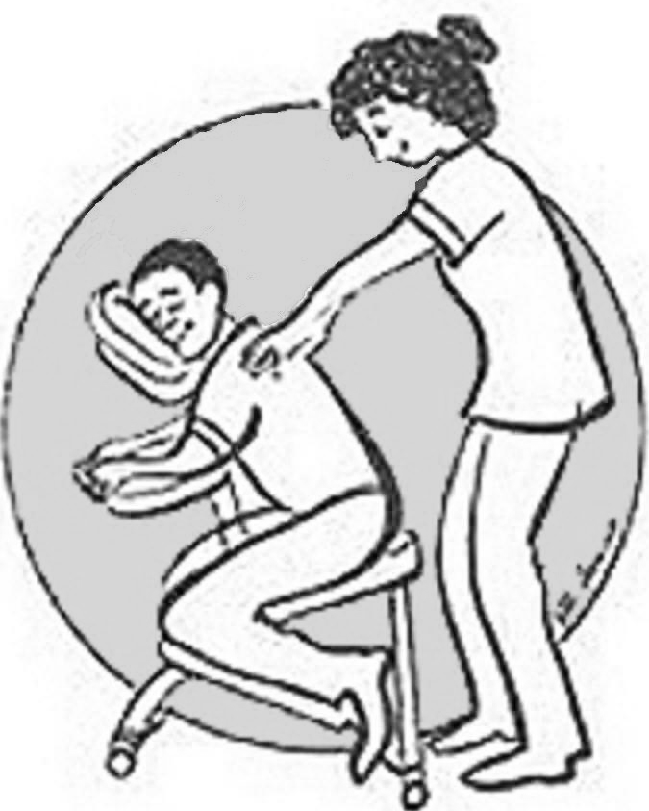

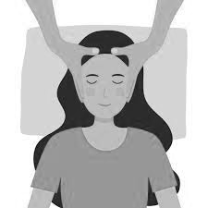
Massage
Foot
Back
Hand
Head
Cuddle Options

Slide 26
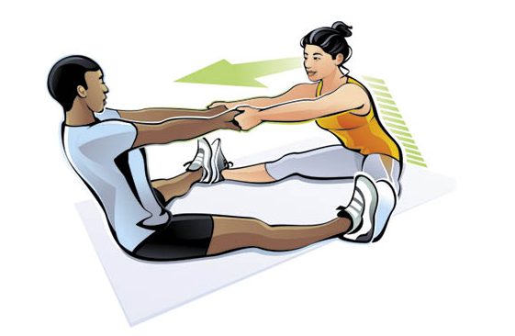
Partner Stretching
Cuddle Options

Slide 27

Talk
(Active listening is a form of touch)
Cuddle Options

Slide 28

Yin-Yang
Cuddle Options

Slide 29
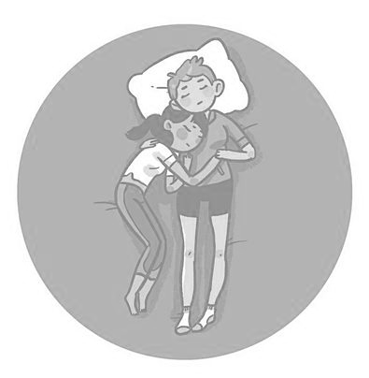
Half Spoon
Cuddle Options

Slide 30
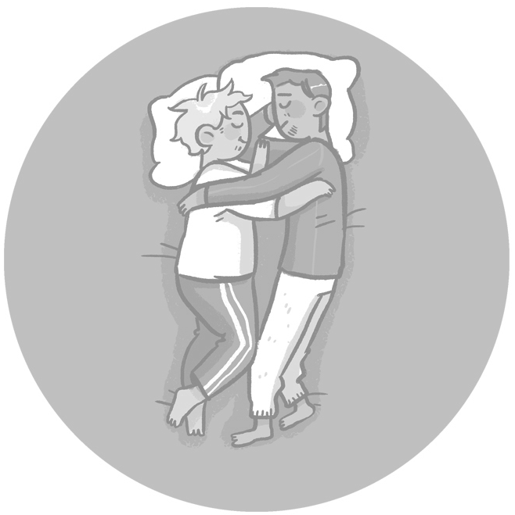
Face to Face
Cuddle Options

Slide 31
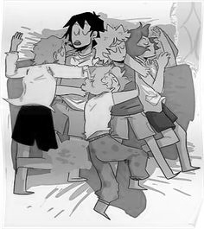
Cuddle Puddle
Cuddle Options

Slide 32
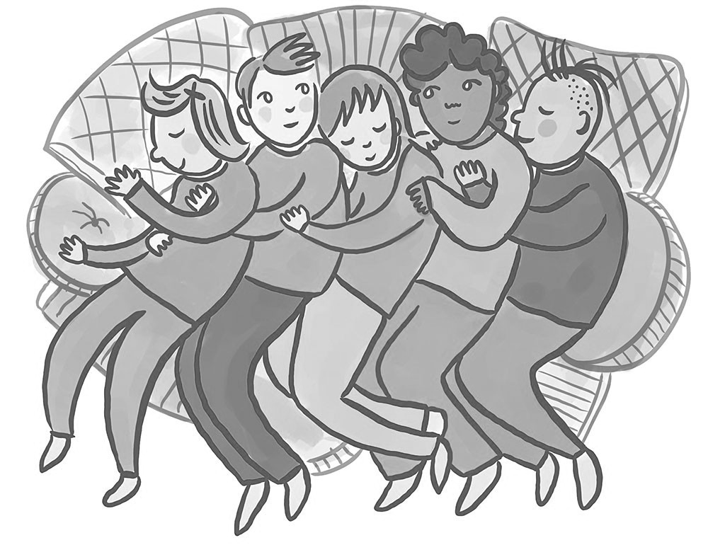
Spoon Drawer
Cuddle Options

Slide 33
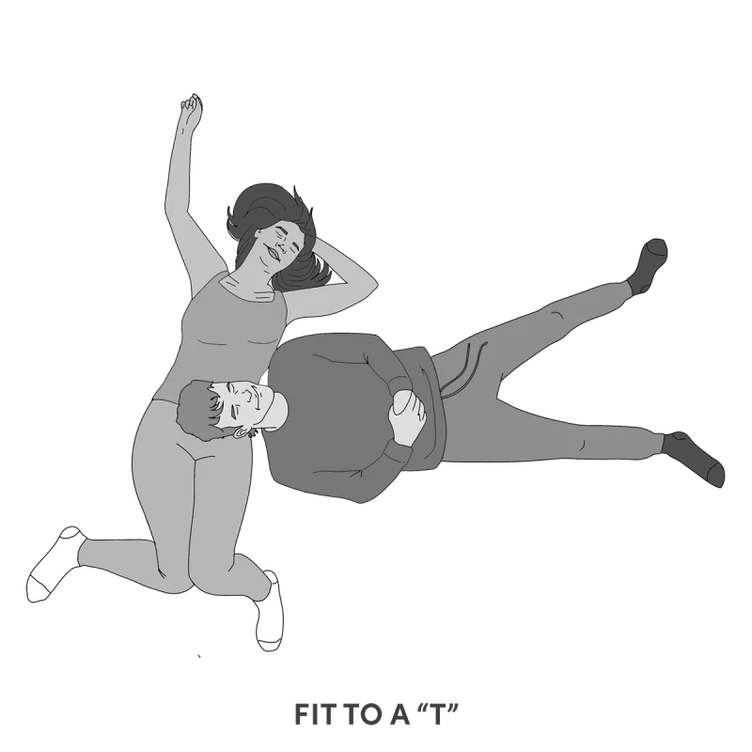
Head in Lap
(laying down)
Cuddle Options

Slide 34
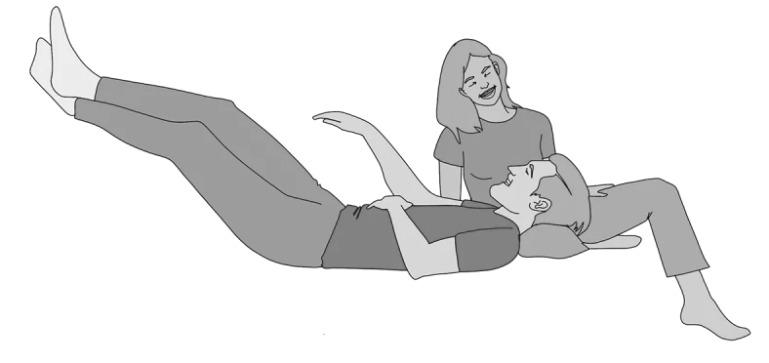
Head in Lap
(sitting)
Cuddle Options

Slide 35
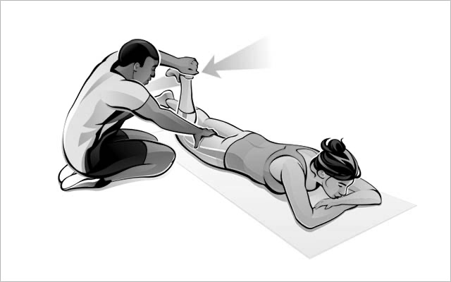
Joint Movement
(for Range of Motion)
Cuddle Options

Slide 36

Brush or play with someone’s hair
Cuddle Options

Slide 37
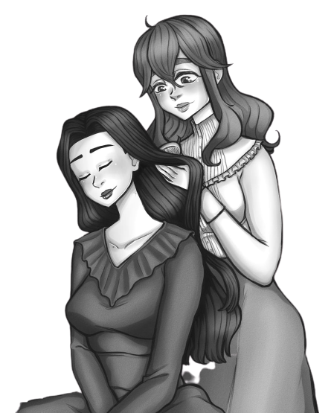
Brush or play with someone’s hair
Cuddle Options

Slide 38
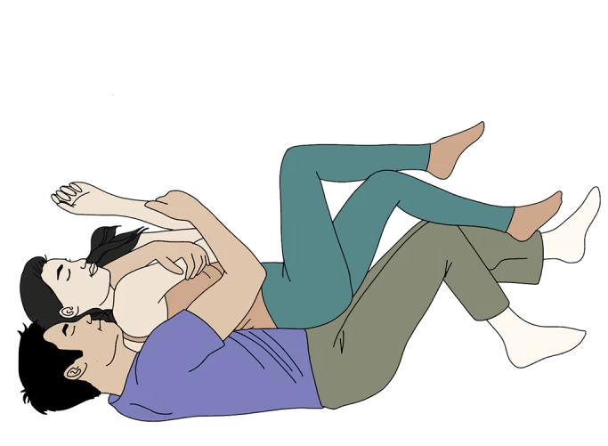
Spooning
Cuddle Options

Slide 39

Back-to-Back
Cuddle Options

Slide 40

Front-to-Back
Cuddle Options

Slide 41
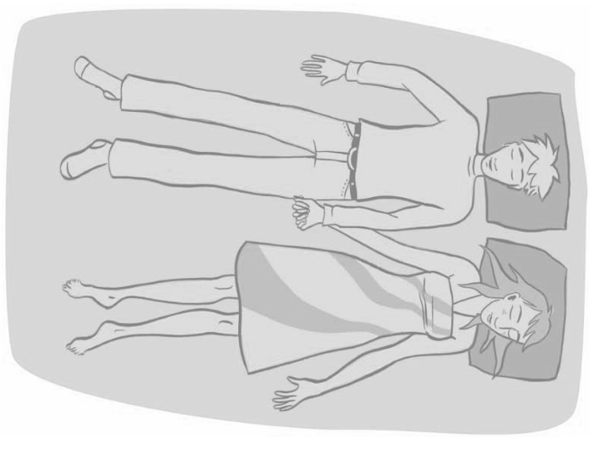
Side-to-Side
Cuddle Options

Slide 42
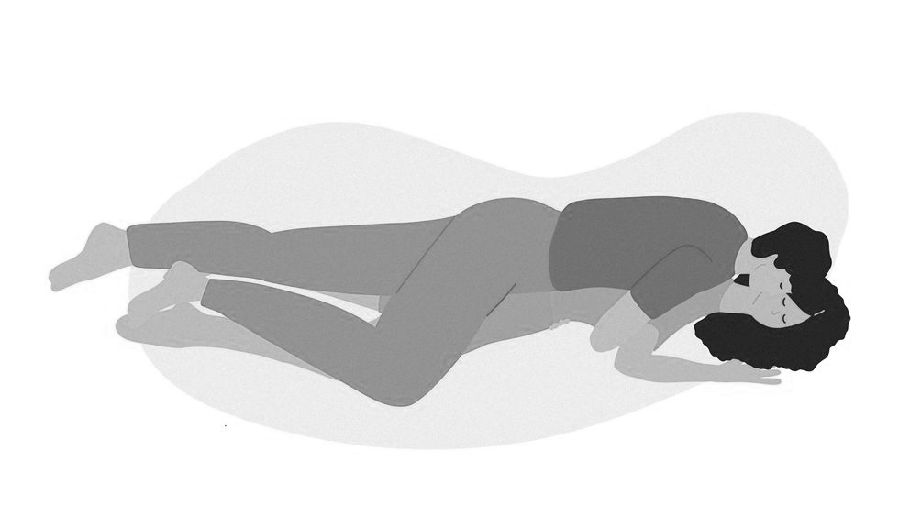
The Squish
Cuddle Options

Slide 43
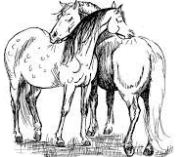
Back Scratches
Cuddle Options

Slide 44
Welcome

Slide 45
CLOSED
No Entry

Slide 46

Anderson Ave SE
Carlisle Blvd Se
No entry after 3:00pm

Slide 47
Anderson Ave SE
Carlisle Blvd Se
No entry after 2:10pm

Slide 48
CLOSED
No Entry
No entry after 3:00pm

Slide 49
☺

Slide 50
☹

Slide 51
Next Time…

Slide 52
Anderson Ave SE
Carlisle Blvd Se

